Slide 1
Banner Reconciliation Concepts & Navigation

Slide 2
Access to Banner Finance
Access to Banner Finance is needed if you:
Need to review budget status for organizations under your department
Need to input online requisitions for your department
To request access, complete Banner Finance Access Request Form.
Form is available to download on the Business Office website https://finance.southtexascollege.edu/businessoffice/BO-forms.html

Slide 3
Forms Overview
Form | Description
FGIBAVL | Use the Budget Availability Status Form to view an online query of the budget availability for a selected fund, organization, account, and program combination.
FGIBDST | Use the Organization Budget Status Form to view an online query of the budget availability by organization code.
FGITRND | Use the Detail Transaction Activity Form to display an online view of detailed transaction activity for operating ledger accounts.
FOIDOCH | The Document History Form displays the processing history of purchasing and payment documents. It identifies and provides the status of all documents in the processing path for the document you select.
FOIAPPH | The Document Approval History Form provides an online display of the approval history for a specified document.
FTMORGN | Use the Organization Code Maintenance Form to establish organization codes representing functions and departments within your site.
FTMFUND | The Fund Code Maintenance Form enables you to establish fund codes for a specific chart of accounts

Slide 4
Filters and Wildcards
Filter-Retrieve information based on criteria
Accessible through the Sub-Menu on every page when applicable or through the shortcuts below.
Filter Shortcuts |  | Action
(F7) |  | Brings up the filter screen
(F8) |  | Performs the query based on the criteria entered
ESC or Ctrl + Q |  | Cancels the query

Slide 5
Query/Filter and Wildcards
Wildcards-Used to represent characters within a query
“%” can be used to represent any character
“_” can be used to represent one character
Query Criteria | Action
71% | Query for all operating records
73% | Query for all travel records
74% | Query for all capital records
%JAN% | Query for all January records
%2018 | Query for all 2018 records
_m% | Query for all records that have “m” as the second letter

Slide 6
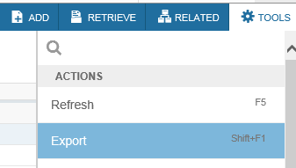
Extracting Data to Excel
Click on “TOOLS”
Click on “Export”
Either save or open file as prompted
Or simply use the shortcut key “Shift+F1” then save or open file

Slide 7
Review Budget Status on FGIBAVL
FGIBAVL is the form Banner uses to check Non-Sufficient Funds (NSF).
The available balance on FGIBAVL is reduced by complete, incomplete, suspended, and unapproved transactions (requisitions, POs, invoices and journal entries).

Slide 8
Review Budget Status on FGIBDST
Unlike FGIBAVL, only complete and fully approved documents post to FGIBDST.
FGIBDST also provides a more detailed summary by account code while FGIBAVL shows a summary by account pool.

Slide 9
Available Balance Calculation on FGIBAVL and FGIBDST
Adjusted Budget
- Year-to-Date (YTD) Activity
- Commitments (Encumbrances)
= Available Budget Balance

Slide 10
Transaction Detail - FGITRND
The Document column can help you determine the source of the transaction:
“I” documents are Invoices
“J” documents are Journal Entries
“F” documents are Feed transactions
“T” documents are Travel transactions
The Field column can help you determine the type of transaction:
OBD – Budget transaction (original budget)
ABD – Budget transaction (adjusted budget-budget transfers)
RSV – Encumbrance transaction from requisition
ENC – Encumbrance transaction from PO
YTD – Expense transaction from invoice, journal entry, or feeds

Slide 11
Transaction Cycle

Slide 12
Document Inquiry Forms
FPIREQN – Requisition Query Form
FPIPURR – Purchase Order Query Form
FAIINVE – Invoice Query Form
FGIDOCR – Document Retrieval Inquiry

Slide 13
Banner Data Extracts
Banner data can be extracted on various forms.
FGIBDST – Report of Summary by Account
FGITRND – Report of Detail Transactions
To extract data, go to form and click on
Tools / Export

Slide 14
Reconciliation Tips
Reconcile the account pools separately.
Extract detail transactions from FGITRND for each account pool separately.
71 - Operating Transactions
73 - Travel Transactions
74 - Capital Transactions

Slide 15
Reconciliation Tips
On Reconciliation Worksheet, associate related documents based on the requisition. For example, the PO(s) and Invoice(s) related to the same requisition.
Use FOIDOCH to find associated documents.

Slide 16
FOIDOCH - Associated Documents
REQ – Requisition
PO – Purchase Order
INV – Invoice
Enter document number

Slide 17
Reconciliation Tips
Make sure totals for Budget, YTD Activity, and Commitments tie to FGIBDST for each pool.
Uncheck “Include Revenue Accounts” to get net totals
71 – Operating Transactions
73 – Travel Transactions
74 – Capital Transactions

Slide 18
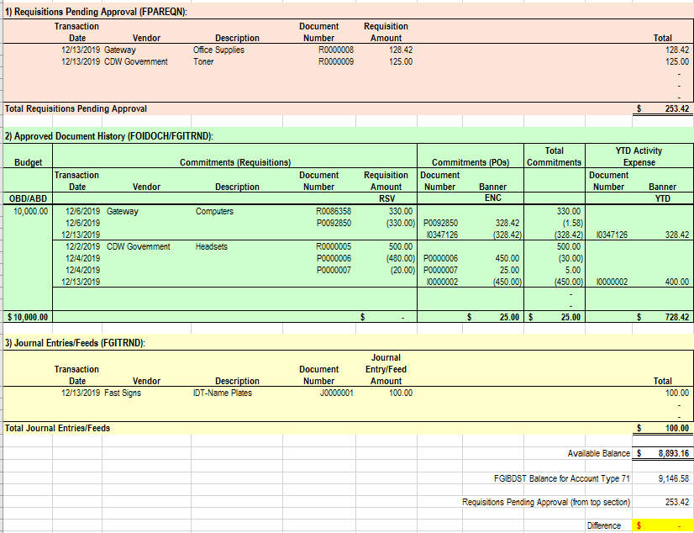
Reconciliation Worksheet
Should tie to FGIBDST Net Totals
Check Figure to make sure Available Balance ties to FGIBDST

Slide 19
Update Reconciliation
Update Reconciliation Worksheet as new requisitions are created and with transactions posted after last reconciliation update
Print Banner screens as backup documentation

Slide 20
Document Approval History - FOIAPPH
When navigating to FOIAPPH, filter screen is displayed. Select your search criteria then press “Go” to continue.
This should bring up the approval history of the document in question.
Non-grants approval queue
Level 5 | Purchasing
Level 10 | Budget Control
Level 20 | Financial Manager
Level 30 | Purchasing Director
Grants approval queues
Level 5 | Purchasing
Level 10 | Financial Manager
Level 20 | Grants Office
Level 30 | Purchasing Director

Slide 21
Organization Code Maintenance - FTMORGN
Use shortcut key “F7” or click on Filter to enter query mode. Select your filter choices and press “Go” when ready.
This will bring up the current record for your search criteria.

Slide 22
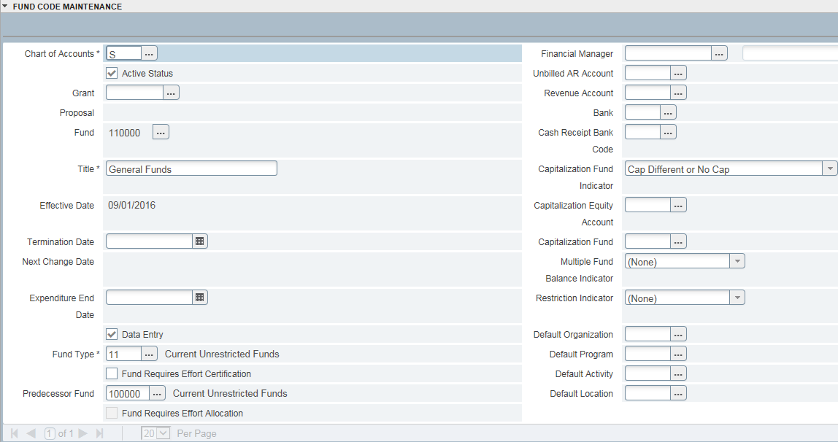
Fund Code Maintenance - FTMFUND
Use shortcut key “F7” or click on Filter to enter query mode. Select your filter choices and press “Go” when ready.
This will bring up the current record for your search criteria.

Slide 23
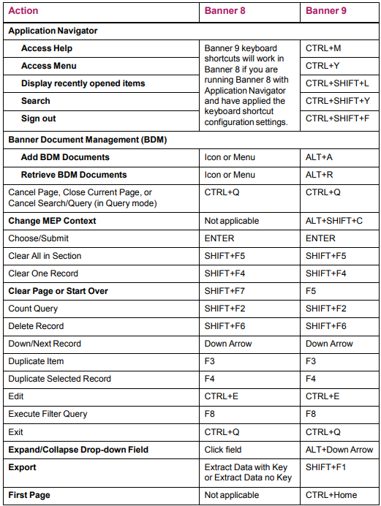
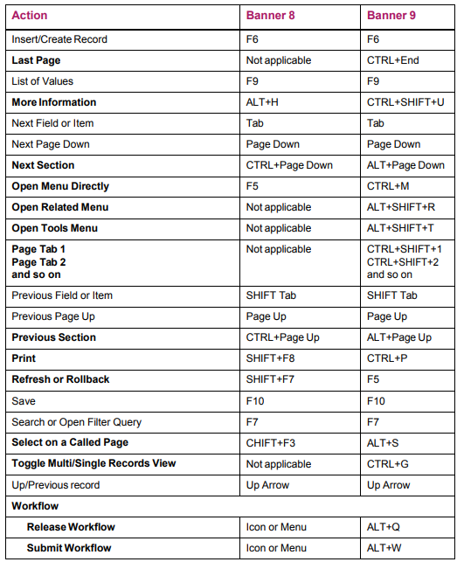
Shortcuts

Slide 24
Transaction Questions
Transaction | Department | Phone Number
Encumbrances (Requisitions or Purchase Orders) | Purchasing | 872-4681
Payments (Invoices) | Accounts Payable | 872-4609
Journal Entries | General Accounting | 872-4638 or 872-4650
Budget Availability | Budget | 872-4620
Finance Access | FAS – Business System Analyst | 872-4663

Slide 25
Thank you! Questions?

